Slide 1
GIS DATA STRUCTURES
There are two fundamental approaches to the representation of the spatial component of geographic information:
Vector Model
Raster Model

Slide 2
Vector Model
The first model of indicating geographical space, called vector, allows us to give specific spatial locatitions explicitly. The vector data structure is representative of dimensionally as it would appear on a map (DeMers, 1997). The vector data model provides for the precise positioning of features in space. Based on analytical geometry, a vector model builds a complex representation from primitive objects for the dimensions: points, lines and areas.

Slide 3
Vector Model
There are several ways in which vector data structures can be put together into a vector data model, enabling us to examine the relationships between variables in a single coverage or among the different coverages. The topological data model is more commonly used in software that implements a full range of operations on vector representations. The topological model incorporates network relationships along with the coordinate measurements (Chrisman, 1997).

Slide 4
Raster Model
The raster data model serves to quantize or divide space as a series of packets or units, each of which represents a limited, but defined, amount of the earth’s surface. The raster model can define these units in any reasonable geometric shape, as long as the shapes can be interconnected to create a planar surface representing all the space in a single study area.

Slide 5
Raster Model
The raster model divides the earth into rectangular building blocks as grid cells or pixels that are filled with the measured attribute values. The location of each cell or pixel is defined by its row and column numbers. Raster data structures do not provide precise locational information therefore it may seem to be rather undesirable (DeMers, 1997).

Slide 6
Comparison Between Vector and Raster Data Model
Advantages
It is a simple data structure
Overlay operations are easily and efficiently implemented
High spatial variability is efficiently represented in a raster format
The raster model is more or less required for efficient manipulation and enhancement of digital images
Disadvantages
The raster data structure is less compact data compression techniques (an often overcome this problem)
Topological relationships are more difficult to represent
The output of graphics is less aesthetically pleasing because appearancerather than the smooth lines of hand-drawn maps. This can be overcome by using a very large number of cells, but may result in unacceptably large files

Slide 7
Comparison Between Vector and Raster Data Model
Advantages
It provides a more compact data structure than the raster model
It provides efficient encoding of topology and as a result more efficient implementation of operations that require topological information, such as network analysis
The vector model is better suited to supporting graphics that closely approximate hand-drawn maps
Disadvantages
It is a more complex data structure than a simple raster
Overlay operations are more difficult to implement
The representation of high spatial variability is inefficient
Manipulation and enhancement of digital images cannot be effectively done in the vector domain

Slide 8
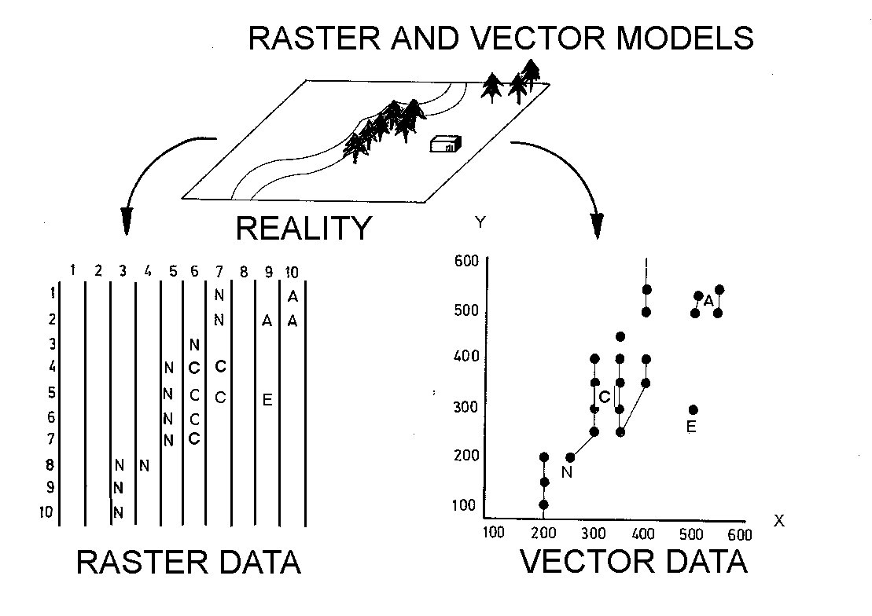

Slide 9
Digital Remote Sensing Imagery
Remote Sensing is a data acquision technique. The remotely sensed data are an ever increasing input to GIS databases, especially where large areas must be analyzed and repeat coverage is necessary due to rapidly changing contitions. Sensors differ widely in the portion of the electromagnetic specturum used to evaluate earth features. In addition, they vary in their ability to be electronically manipulated to produce meaningful categories..

Slide 10
Digital Remote Sensing Imagery
There are two major products derived for input to the GIS. These are digitally enhanced imagery and classified images. As an input to GIS, the classified images is used to update and/or compare with the classified data already inside the GIS

Slide 11
Integration of GIS and Remote Sensing Data
Remote sensing data can be readily merged with other sources of geo-coded information in a GIS. This permits the overlapping of several layers of information with the remotely sensed data, and the application of a virtually unlimited number of forms of data analysis. On the one hand, the data in a GIS might be used to aid in image classification. On the other hand, the land cover data generated by a classification might be used in subsequent queries and manipulations of the GIS database (Lillesand and Keifer, 1987).

Slide 12
Integration of GIS and Remote Sensing Data
For the last twenty years, satellite remote sensing has been used to collect data that is used mainly for regional planning and small-scale studies. However, new developments have considerably increased the potential use of satellite images for urban applications. GIS increasingly are being used to collect, store, analyze and display maps and other spatial information. A GIS can help to improve the management and use of this information at all levels of an organization.

Slide 13
Integration of GIS and Remote Sensing Data
One of the most important advantages of a GIS is the possibility of combining data from different sources and of exchanging information between organizations. By using a computerized GIS it is possible to improve the interpretation and analysis of remote sensing images by data from several sources. Vector data can be converted to raster data and used as another layer in a raster database. This additional layer can be used in the classification process or it can be used in GIS (Erdas, 1991).

Slide 14
Urban Planning Applications of GIS
GIS can be applied to many types of problem. Among these are representatives of both raster and vector data base structures, both simple and complex analytical models. Master planning applications are one of them.

Slide 15
Urban Planning Applications of GIS
Among others proposed dam site, waste site selection, irrigation and water resource potential, merging raster and vector data for map update, species habitat analysis, agricultural production modeling can be noted. There are many possibilities for application of the GIS technology in urban and regional planning. With respect to background studies, GIS can be employed for nearly all research that involves land based spatial analysis and modeling.

Slide 16
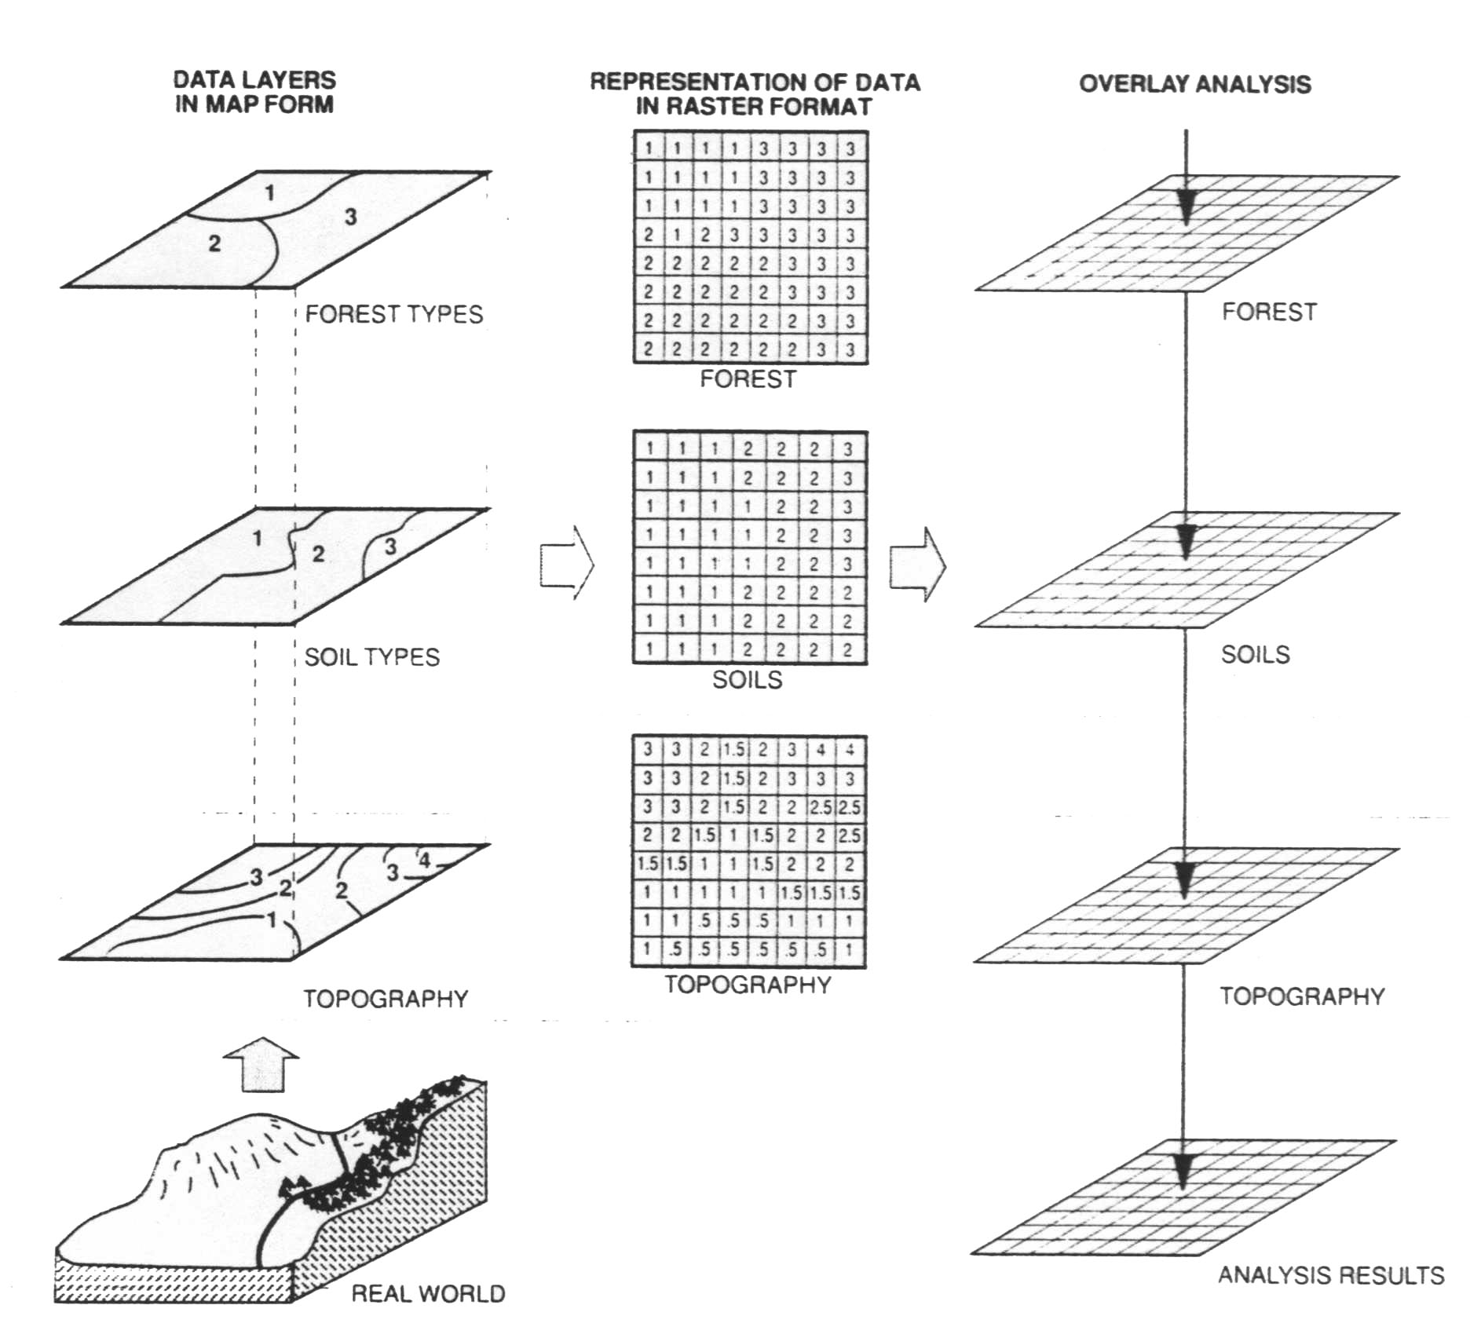

Slide 17
Urban Planning Applications of GIS
Especially for area monitoring (both on a sectoral and integral basis), regional potential and feasibility analyses and site selection studies. For studies in which plan alternatives are generated, much more flexible design, optimization and evaluation tools would be needed in order to give GIS a dominant position in the development process.

Slide 18
Urban Planning Applications of GIS
GIS can also be helpful for the documentation of spatial plans and in the approval process for the development, building and installation permits.
GIS applied to a wide range of land management and land use planning issues including the interpretation and formulation of land use policy. Land-use policy can be interpreted within GIS using a modeling approach.

Slide 19
Urban Planning Applications of GIS
Output in the form of maps showing areas in which land-use changes are more likely to occur, and statistics, graphs and tables summarizing this information according to a variety of specified spatial units. Such output allows land-use implications to be discussed.
The predicted land-use changes can also form input for GIS-based impact assessment.

Slide 20
Urban Planning Applications of GIS
GIS have become of increasing significance for environmental planning and assessment in recent years. One reason for this, a great number of spatial data with their attributes is involved in environmental planning. GIS represents a highly efficient instrument for such planning tasks. GIS can be used to develop natural and cultural resource inventory to identify contamination sources, to assess environmental constraints, selection of sites for land application of sewage waste. Suitability for several treatment techniques can be considered using soil, topographic and land use factors, integrated with information about the biological, chemical and physical properties of waste.

Slide 21
Urban Planning Applications of GIS
Wetland applications of GIS are another examples. Wetland issues have become a major source of interest to the professional and to the public.Unlike other environmental issues that are localized or found only in certain areas, wetlands are found almost everywhere. GIS and remote sensor technologies supply information of a more general nature. In a regional inventory satellite and high altitude image data sets can provide a valuable resource or focal point for data analyses.

Slide 22
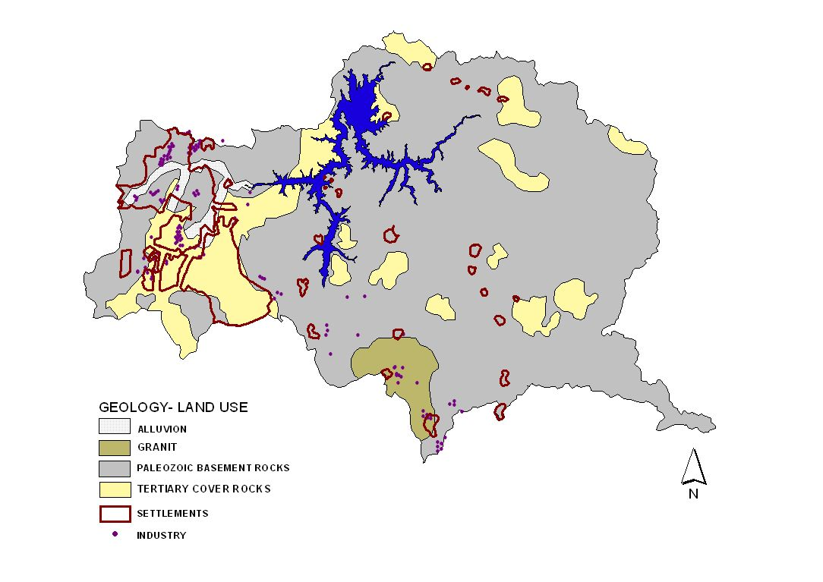

Slide 23
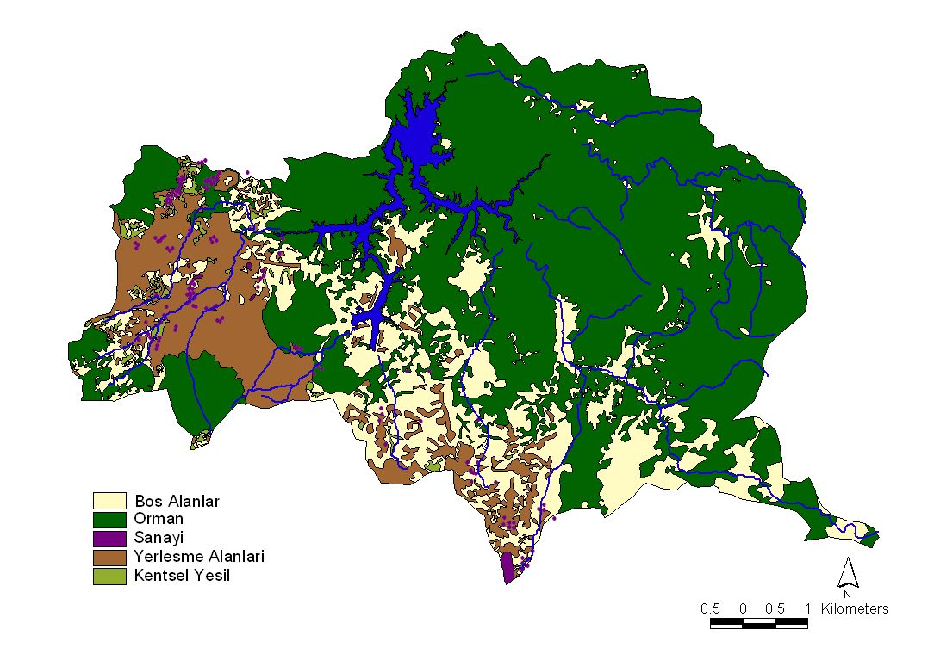

Slide 24
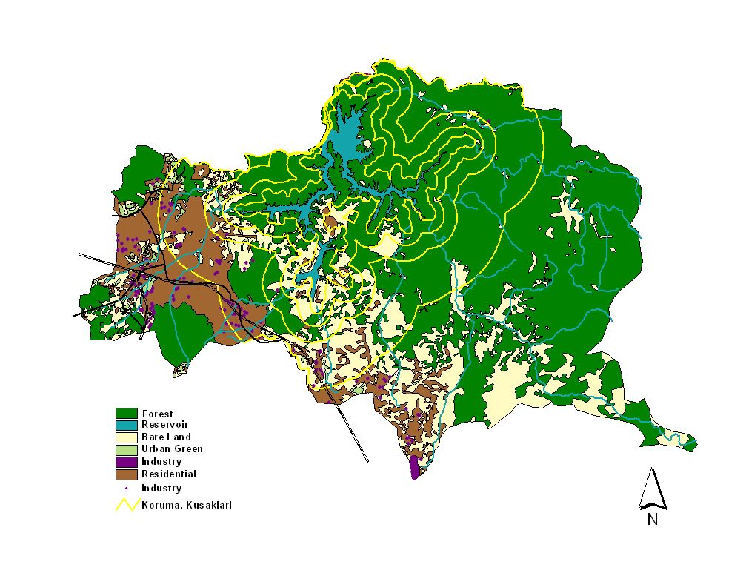

Slide 25
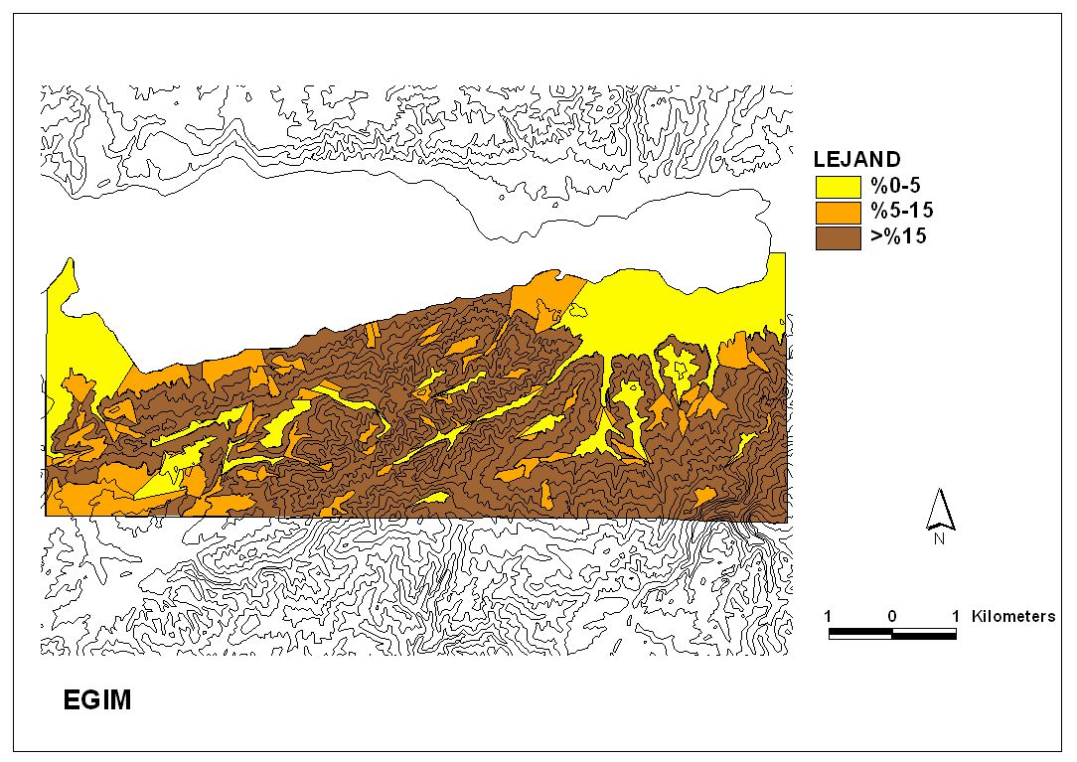

Slide 26
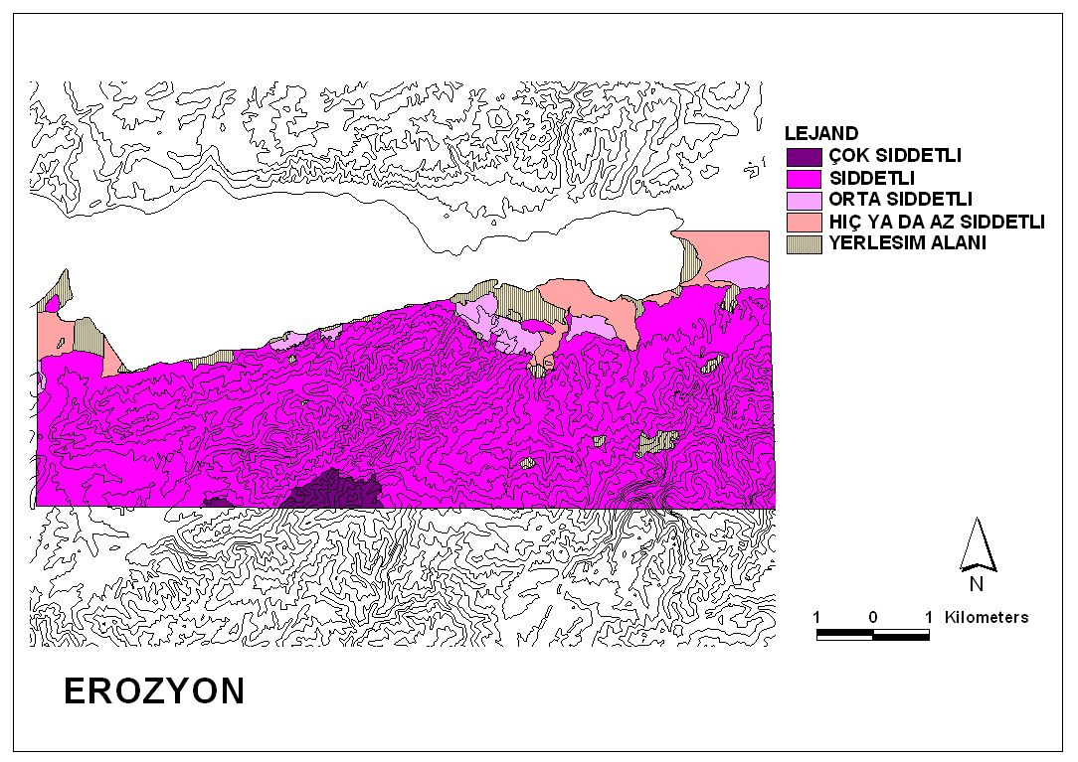

Slide 27
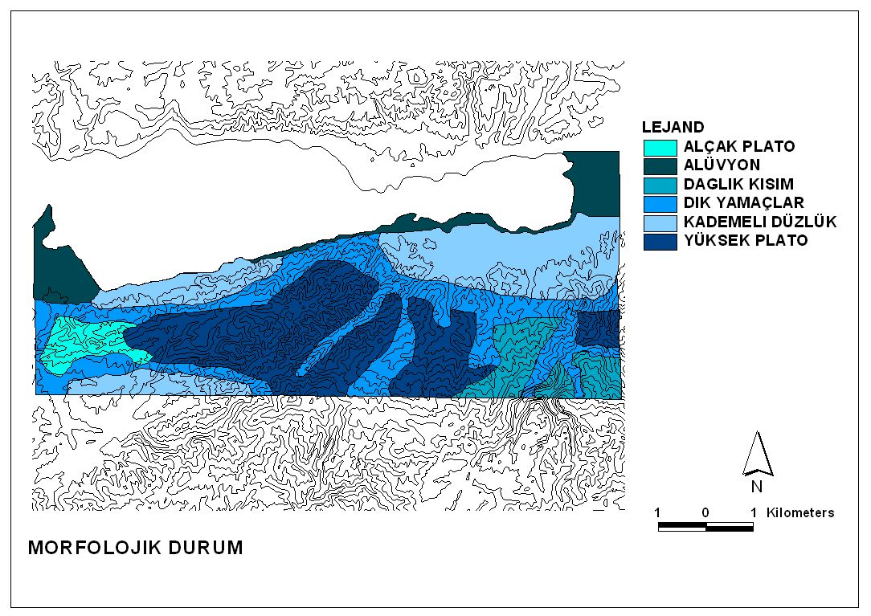

Slide 28
